Slide 2
Business Proposition: Tech Creep Across Industries
Technology Creep Across Industries

Slide 3
Business Proposition: Investment Manager
Value-Added-Research
Risk-Management Tool
Important Considerations:
Qualitative Support
Interpretability
Scalability
Reliability

Slide 4
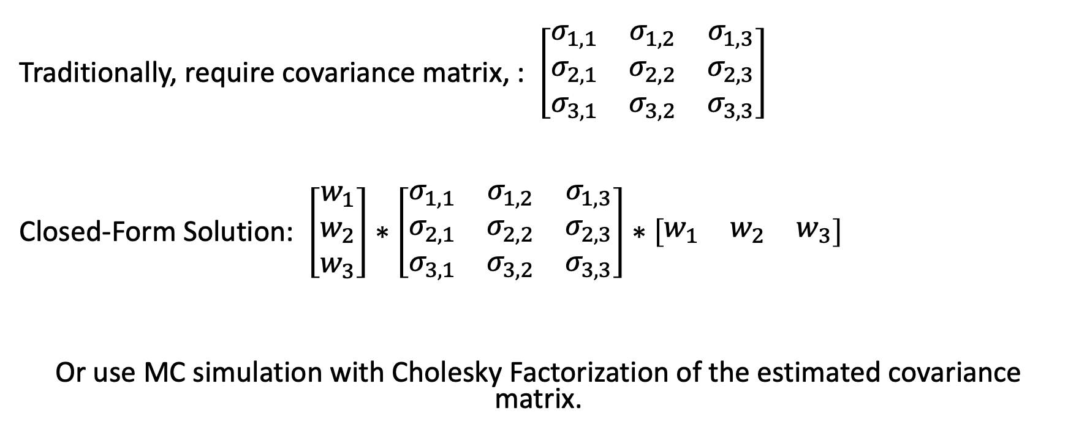
Modeling Concepts for Portfolio Variance
Traditionally, require covariance matrix, : $\left[\begin{matrix}σ_{1,1} & σ_{1,2} & σ_{1,3} \\ σ_{2,1} & σ_{2,2} & σ_{2,3} \\ σ_{3,1} & σ_{3,2} & σ_{3,3}\end{matrix}\right]$
Closed-Form Solution: $\left[\begin{matrix}w_{1} \\ w_{2} \\ w_{3}\end{matrix}\right]∗\left[\begin{matrix}σ_{1,1} & σ_{1,2} & σ_{1,3} \\ σ_{2,1} & σ_{2,2} & σ_{2,3} \\ σ_{3,1} & σ_{3,2} & σ_{3,3}\end{matrix}\right]∗\left[\begin{matrix}w_{1} & w_{2} & w_{3}\end{matrix}\right]$
Or use MC simulation with Cholesky Factorization of the estimated covariance matrix.

Slide 5
Universe

Slide 6
Sample: Tech/Tech-Adj. Stocks
METADATA
Co. Name | Ticker | SIC
Apple | AAPL | ELECTRONIC COMPUTERS [3571]
Amazon | AMZN | RETAIL-CATALOG & MAIL-ORDER HOUSES [5961]
Best Buy | BBY | RETAIL-RADIO TV & CONSUMER ELECTRONICS STORES [5731]
Google | GOOGL | SERVICES-COMPUTER PROGRAMMING, DATA PROCESSING, ETC. [7370]
Netflix | NFLX | SERVICES-VIDEO TAPE RENTAL [7841]

Slide 7
Annual Correlations
2016 | Apple | Amazon | Best Buy | Google | Netflix
Apple
Amazon | 0.35
Best Buy | 0.12 | 0.02
Google | 0.47 | 0.60 | 0.09
Netflix | 0.31 | 0.38 | 0.08 | 0.42
2017 | Apple | Amazon | Best Buy | Google | Netflix
Apple
Amazon | 0.51
Best Buy | 0.04 | -0.01
Google | 0.49 | 0.67 | 0.03
Netflix | 0.34 | 0.40 | 0.06 | 0.49
2018 | Apple | Amazon | Best Buy | Google | Netflix
Apple
Amazon | 0.66
Best Buy | 0.44 | 0.47
Google | 0.68 | 0.75 | 0.45
Netflix | 0.55 | 0.73 | 0.41 | 0.65

Slide 8
Example-Clustering by Year
Universe: Stocks with RD text for the past five years: 70 Stocks
TfIDF Vectorization
Agglomerate Clustering w/ ‘n_clusters’ parameters set to 5.

Slide 9
Example Dataset
Name | SIC |  | Name | SIC |  | Name | SIC |  | Name | SIC |  | Name | SIC |  | Name | SIC |  | Name | SIC
A10 NETWORKS | 3576 |  | Best Buy | 5731 |  | Expedia | 4700 |  | Live Nation Entertainment | 7900 |  | Qualcomm | 3663 |  | T-Mobile | 4812 |  | Emerson Radio | 3600
Adobe | 7372 |  | Black Knight Inc | 7372 |  | Facebook | 7370 |  | Micron Technology | 3674 |  | Quotient Technology | 7310 |  | Twilio | 7372 |  | Chegg | 8200
Advanced Micro Devices | 3674 |  | Booking Holdings Inc. | 4700 |  | Five9 Inc | 7374 |  | Motorola Solutions | 3663 |  | Sabre Corp | 7370 |  | Twitter | 7370 |  | Interactive Corp | 7370
Akamai Technologies | 7389 |  | Boston Scientific | 3841 |  | Fleetcor | 7389 |  | NetApp Inc. | 3572 |  | Salesforce | 7372 |  | Upland Software | 7372 |  | Sirius Radio | 4832
Amazon | 5961 |  | Charter Comm. | 4841 |  | Gamestop | 5734 |  | Netflix | 7841 |  | ServiceNow Inc. | 7372 |  | Verisign | 7371 |  | Sinclair Broadcasting | 4833
AMC NETWORKS | 4841 |  | Digital Realty Trust Inc. | 6798 |  | Hewlett Packard Enterprise. | 5045 |  | NVIDIA | 3674 |  | Square | 7372 |  | Verizon | 7389 |  | iHeartMedia | 4832
APPFOLIO | 7372 |  | Dish Network | 4841 |  | HP Inc. | 3570 |  | Omnicom Group | 7311 |  | SS&C | 7372 |  | Workday | 7374 |  | iRobot | 3630
Apple | 3571 |  | Electronic Arts Inc. | 7372 |  | IBM | 3570 |  | Paycom Software Inc. | 7372 |  | Synopsys | 7372 |  | Zendesk | 7374 |  | eBay | 7389
Applied Materials | 3674 |  | Equifax Inc. | 7320 |  | Intuit | 7372 |  | Paypal | 7389 |  | Take-Two | 7372 |  | Knowles | 3651 |  | Match.com | 7200
Autodesk Inc. | 7372 |  | Equinix Inc. | 6798 |  | Lam Research | 3559 |  | Qorvo Inc. | 3674 |  | Texas Instruments | 3674 |  | Zynga | 7374 |  | Interpublic Group | 7311

Slide 10
Example: Annual Results
Counts | 2020 | 2019 | 2018 | 2017 | 2016
Group 1 | 24 | 29 | 23 | 29 | 29
Group 2 | 19 | 23 | 15 | 26 | 28
Group 3 | 24 | 15 | 3 | 3 | 5
Group 4 | 2 | 1 | 16 | 3 | 7
Group 5 | 1 | 2 | 13 | 9 | 1

Slide 11
Example: 2020 Dendogram

Slide 12
Example: 2019 Dendogram

Slide 13
Example: 2018 Dendogram

Slide 14
Example: 2017 Dendogram

Slide 15
Example: Annual Clusters for Stocks w/ SIC 7372
Name | 2020 | 2019 | 2018 | 2017 | 2016
Adobe | 0 | 2 | 4 | 4 | 1
Appfolio | 0 | 2 | 2 | 4 | 1
Autodesk | 0 | 2 | 4 | 1 | 1
Black Knight | 1 | 1 | 0 | 0 | 0
Electronic Arts | 2 | 0 | 0 | 0 | 1
Intuit | 0 | 2 | 4 | 1 | 1
Paycom | 1 | 1 | 2 | 2 | 2
Salesforce | 0 | 2 | 4 | 4 | 1
ServiceNow | 0 | 2 | 4 | 4 | 1
Square | 0 | 0 | 3 | 0 | 0
SS&C | 1 | 0 | 0 | 0 | 0
Synopsys | 2 | 0 | 4 | 1 | 1
TakeTwo | 2 | 0 | 4 | 4 | 1
Twilio | 2 | 0 | 4 | 4 | 1
Upland Software | 0 | 2 | 2 | 2 | 2
Interesting Sets:
Black Knight & SS&C vs. Intuit
Electronic Arts & Take-Two
Appfolio, Upland, & Twillio
Autodesk, Adobe, & Synopsys
Salesforce & ServiceNow

Slide 17
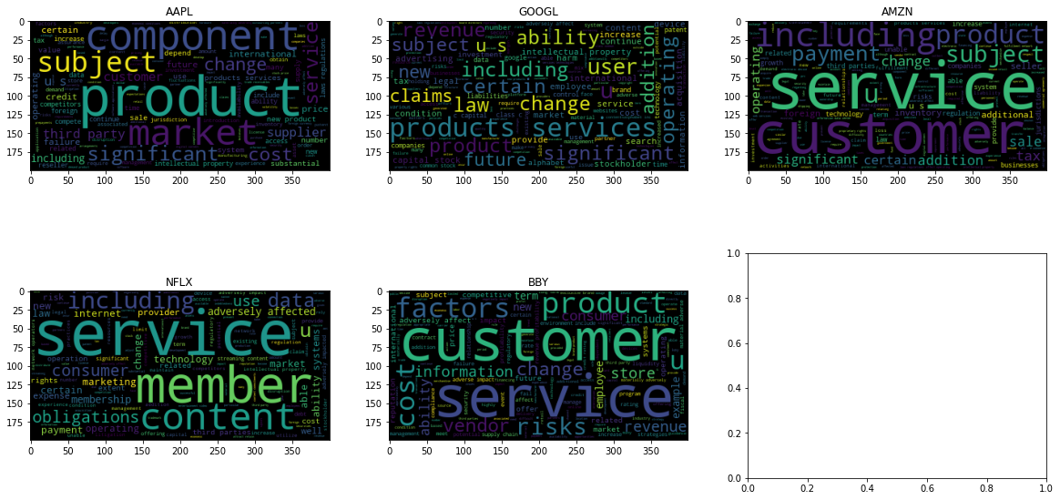
World Cloud-2015

Slide 18
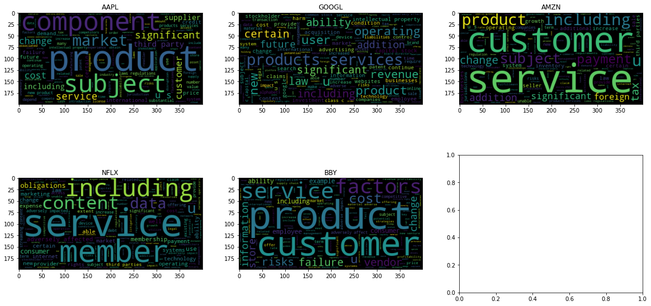
Word Cloud-2016

Slide 19
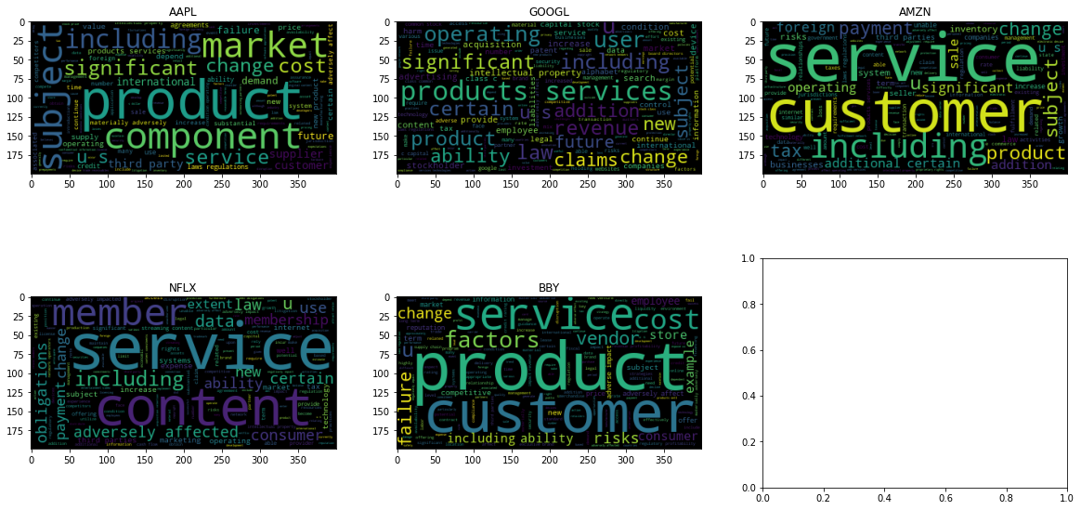
World Cloud-2017

Slide 20
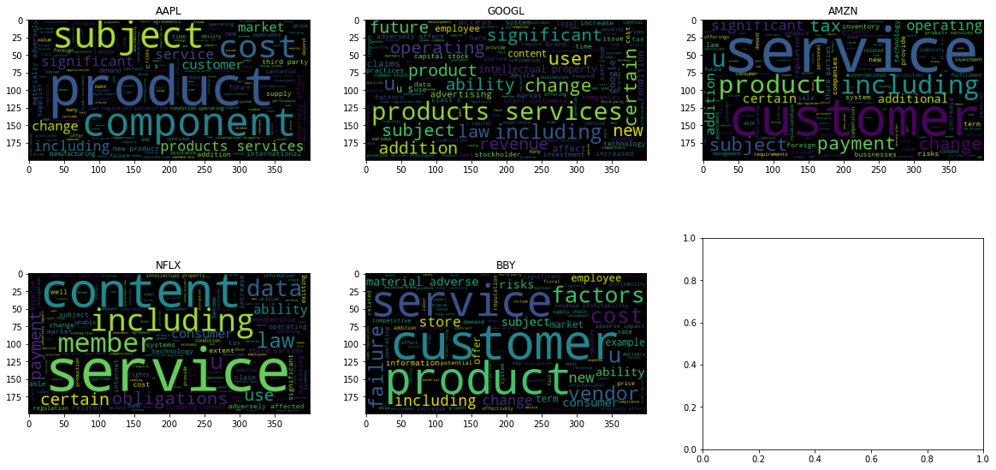
Word Cloud-2018

